Slide 1
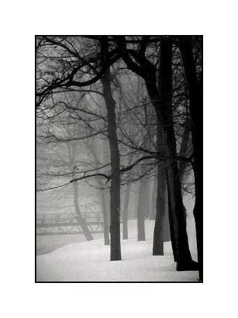

You and a Guest
are invited to Dinner
at Brennan’s
Sunday, December 17, 2000
at 6pm
(Jacket required)
Please RSVP by
Thursday, December 15, 2000

